Slide 1
CSE 2451 Type Qualifiers
Zichen Zhang

Slide 2
Overview
Type qualifiers: keywords used to change a data type’s behavior in C
const
volatile
restrict
Notes:
Source:
https://en.cppreference.com/w/c/language/storage_duration

Slide 3
Type qualifiers
Each individual type in the C type system has several qualified versions of that type, corresponding to one, two, or all three of the qualifiers:
const
volatile
restrict
C type system is consisted of:
type specifiers, e.g., int, long int, static int, extern int, etc.
type qualifiers, e.g., const int, volatile int, const long int, etc.

Slide 4
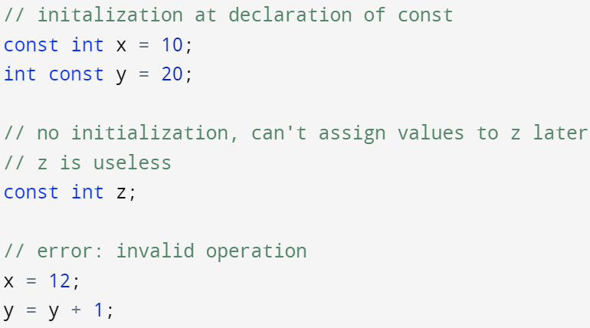
Type qualifiers - const
Can be applied to any type, including structs, unions, and typedef ’ed alias (if a function type is declared with const, it’s undefined behavior)
Specifies that the variable’s value can’t be changed after declaration
Any attempt to modify an object whose type is const-qualified results in undefined behavior
Initialization at declaration
If no initialization at declaration, you can’t assign value to it later, it’s fixed with a random value
Write access is invalid to constant ‘variables’ which is read-only (undefined behavior)

Slide 5
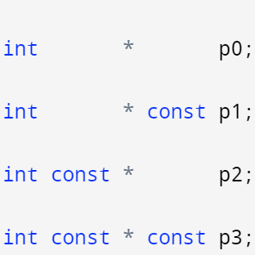
Type qualifiers – const and pointer
const + pointer, two independent cases:
const pointer: can’t change value of the pointer (address stored in pointer)
pointer that points to const variable: can’t change value of object pointed by the pointer through dereference operation
The const applies to whatever is on the left of it:
a pointer to an integer, both can be changed
a constant pointer to an integer, the pointer can't be changed, the integer can be changed
a pointer to a constant integer, the pointer can be changed, the integer can’t be changed
a constant pointer to a constant integer, the pointer can’t be changed, the integer can’t be changed

Slide 6
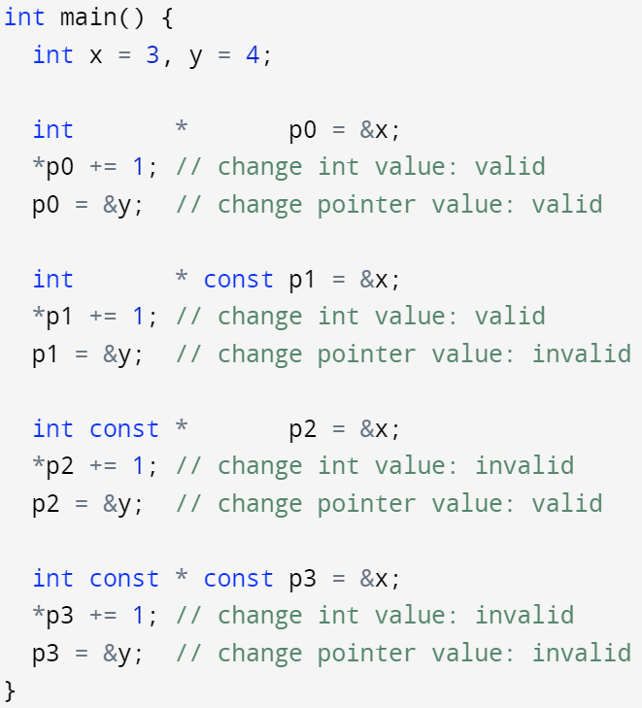
Type qualifiers – const and pointer
constant pointer to variable
Variable address stored in pointer can’t be changed (read-only)
Pointer to constant
Value stored in variable can’t be changed through the pointer (read-only)
The variable being pointed by the pointer is treated as a constant from the pointer’s perspective
Constant pointer to constant
Value stored in variable can’t be changed through the pointer (read-only)
Variable address stored in pointer can’t be changed (read-only)

Slide 7
Type qualifiers – const and pointer
Imposing const-qualifier can be done via implicit conversion
Discarding const-qualifier has to be done via explicit type casting
A pointer to a non-const type can be implicitly converted to a pointer to const-qualified version of the same type
A pointer to const-qualified type can be converted to a pointer to non-const type via explicit type casting
This is problematic: if you cast (int const *) to (int *), then change the associated pointed object’s value via this new pointer without the const qualifier, then you are attempting to change a value that’s const-qualified -> undefined behavior

Slide 8
Type qualifiers – const and pointer
constant pointer to variable
Variable address stored in pointer can’t be changed (read-only)
Pointer to constant
Value stored in variable can’t be changed through the pointer (read-only)
The variable being pointed by the pointer is treated as a constant from the pointer’s perspective
Constant pointer to constant
Value stored in variable can’t be changed through the pointer (read-only)
Variable address stored in pointer can’t be changed (read-only)
&x -> (int *), implicitly covert to (int * const)
&x -> (int *), implicitly covert to (int const *)
&x -> (int *), implicitly covert to (int const * const)

Slide 9
Type qualifiers – const and pointer
Pointer to constant, two equivalent ways of declaration:
int const * ptr (const applies to whatever is on the left of it, i.e., int)
const int * ptr (like char * ptr is pointing “char”, const int * ptr is pointing to “const int”)
Pointer to constant is often used to protect input variables from being corrupted by a function
char * strcpy(char * dest, const char * src); // protect the source string
FILE * fopen(const char * filename, const char * mode); // protect filename and mode
The aforementioned “protect” is from a programming point of view:
It reminds the programmer not to change the associated const-qualified values via pointer
If the programmer attempts to change the const-qualified objects by mistake, compiler will issue error messages
It’s not from the security point of view, i.e., you can explicitly cast these const-qualified types back to normal types (e.g., cast “int const *” to “int *”), then attempt to corrupt the pointed object’s value -> undefined behavior, but could be enough if you just want cause damage

Slide 10
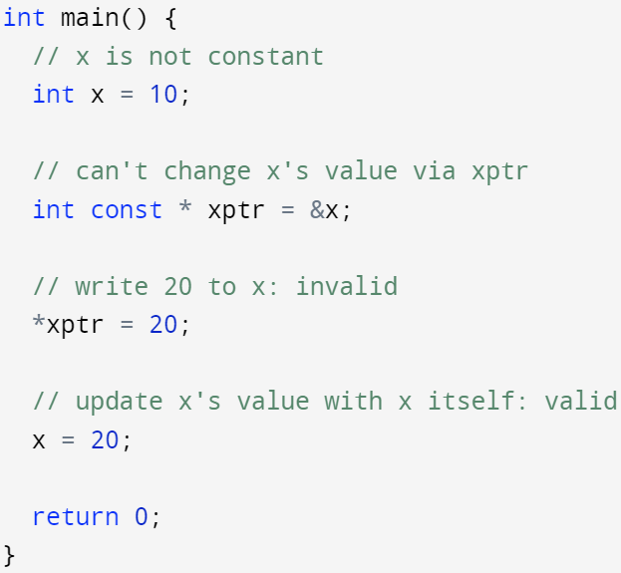
Type qualifiers – const - example
Used to restrict the pointer’s access to the pointed object
The pointed variable itself may not necessarily be const-qualified

Slide 11
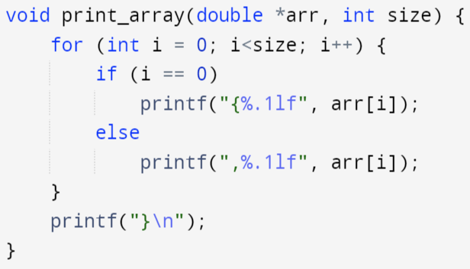
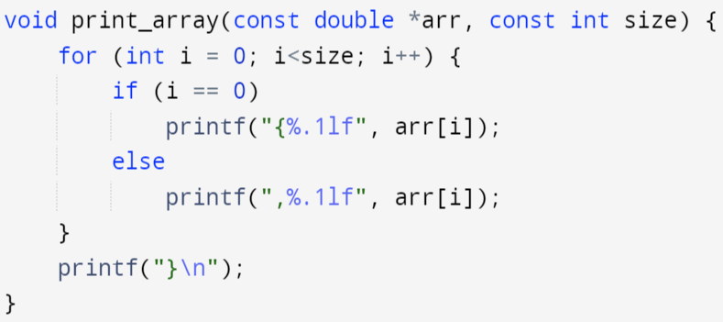
Type qualifiers – const - example
Use const qualifier to protect input arguments
Error prone, if you modified the original input inside the function by mistake, the compiler wouldn’t know -> display corrupted data
Safer, if you modified the original input by mistake, the compiler would output an error message
Gives other programmers a hint that this function does not modify its input data

Slide 12
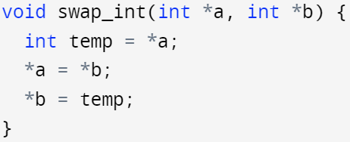
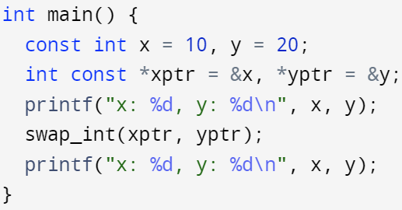
Type qualifiers – const - example
Avoid passing “pointer to constant” objects as arguments to functions that expect non-const qualified pointers: undefined behavior
warning: passing argument 2 of ‘swap_int’ discards ‘const’ qualifier from pointer target type

Slide 13
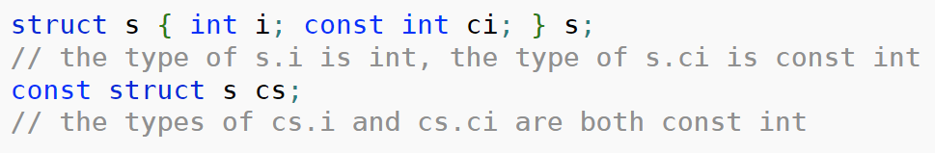
Type qualifiers – const with structed data type
If one member of struct is const-qualified, then simple assignments between objects of the same struct type is not allowed
A member of a const-qualified struct or union type acquires the qualification of the type it belongs to

Slide 14

Type qualifiers – const with array
In a function declaration, the keyword const may appear inside the square brackets that are used to declare an array type of a function parameter.
It qualifies the pointer type to which the array type is transformed (array decay to pointer to its 1st element)
The following two declarations declare the same functions:
1. can’t change x to point to sth else
2. can change the array elements pointed by x
1. can’t change x to point to sth else
2. can’t change the array elements pointed by x

Slide 15
Type qualifiers - volatile
Volatile is intended to tell the compiler that this value can be modified outside the control of the program
It prevents the compiler from applying any optimization on volatile objects
Use cases:
Problems encountered in real-time or embedded systems programming using C
global variables representing a data port which will be updated outside influence of the program (e.g., by some hardware control)

Slide 16
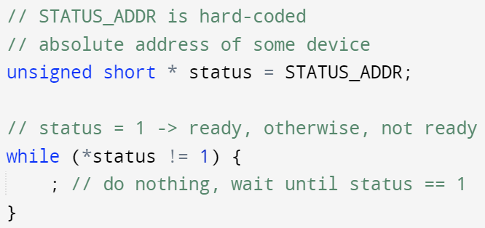
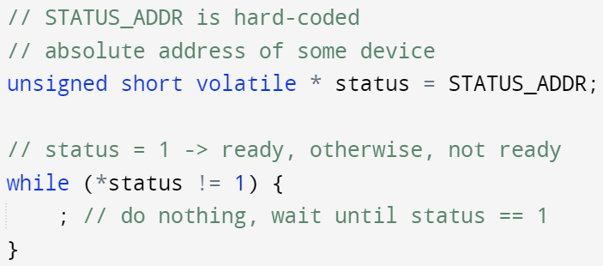
Type qualifiers - volatile
Use volatile to inform compiler/optimizer NOT to cache access to the volatile-qualified object
volatile follows similar syntax as const, it qualifies what is on the left side of it
The compiler notices that while loop keeps accessing the same address in status, and from the source code’s point of view, the value in this address never changed → save the value in this address, and always use it for the != condition expression
No optimization will happen to status to save its value in the cache and always use that value for != condition expression, since status is volatile-qualified

Slide 17
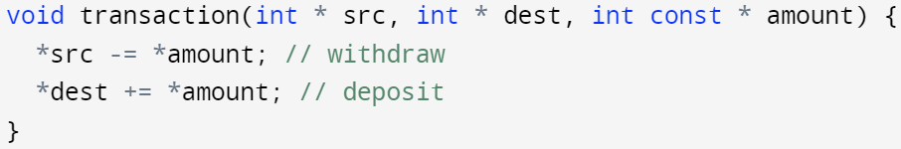
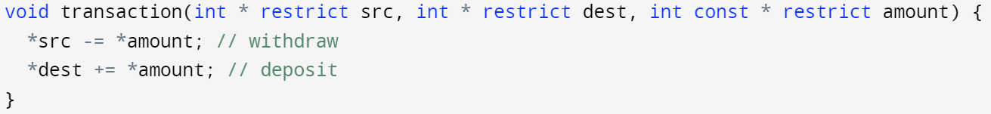
Type qualifiers - restrict
restrict is only used to qualify a pointer to an object type, i.e., any pointers other than a function pointer (note, this includes the pointer decayed from an array’s identifier)
restrict is a ‘promise’ the programmer made to the compiler: its usage represents a guarantee by the programmer that within the scope of the restrict-qualified pointer’s declaration, the object pointed to can be accessed only by that restrict-qualified pointer
This ‘promise’ allows the compiler to do more optimization (when generating the associated assembly code)
If the programmer broke this ‘promise’ → undefined behavior
From compiler’s point of view, there’s no guarantee that src, dest and amount are pointing to different objects → can’t apply optimization, need to ensure correctness
Use restrict to promise to the compiler that src, dest, and amount are pointing to different objects → compiler can optimize for only 1 read from amount pointer
Notes:
Src:
https://www.youtube.com/watch?v=UjnbtIlSE4E

